Slide 1
Video 1: Rounding errors

Slide 2
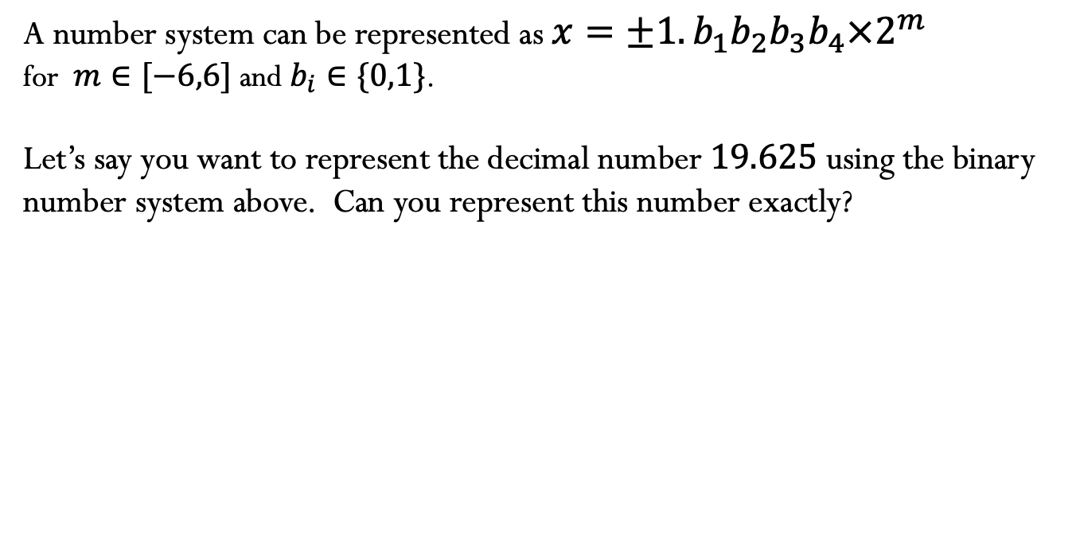
A number system can be represented as $x=±1.b_{1}b_{2}b_{3}b_{4}×2^{m}$
for $m∈[−6,6]$ and $b_{i}∈\{0,1\}$.
Let’s say you want to represent the decimal number $19.625$ using the binary number system above. Can you represent this number exactly?

Slide 3
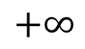
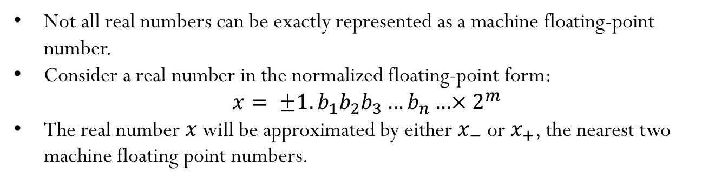
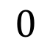
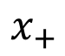
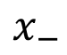
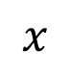
Machine floating point number
Not all real numbers can be exactly represented as a machine floating-point number.
Consider a real number in the normalized floating-point form:
$$x= ±1.b_{1}b_{2}b_{3}…b_{n}…×{ 2}^{m}$$
The real number $x$ will be approximated by either $x_{−}$ or $x_{+}$, the nearest two machine floating point numbers.
$$x_{−}$$
$$x$$
$$x_{+}$$
$$+∞$$
$$0$$

Slide 4
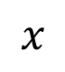
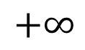

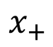
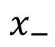
$$x_{−}$$
$$x$$
$$x_{+}$$
$$+∞$$
$$0$$

Slide 5
IEEE-754 Double Precision
The interval between successive floating point numbers is not uniform: the interval is smaller as the magnitude of the numbers themselves is smaller, and it is bigger as the numbers get bigger.

Slide 6
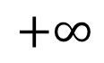
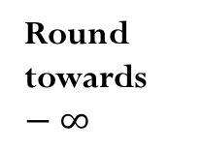
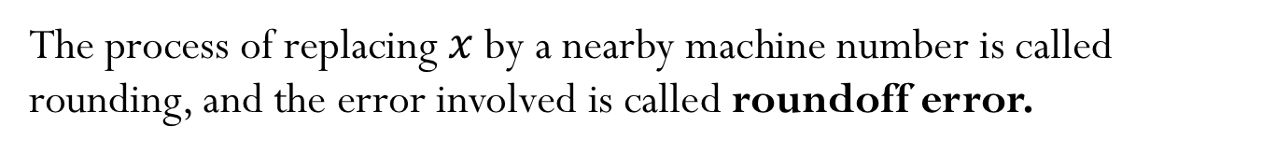
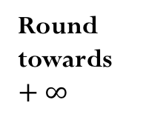
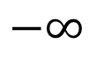
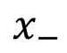
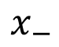
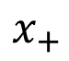
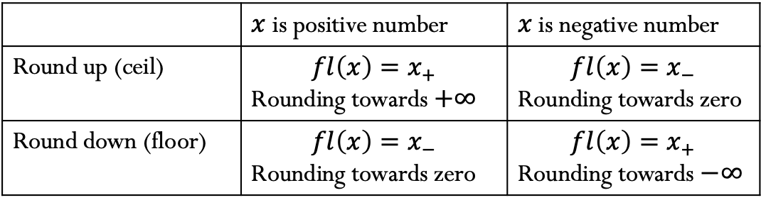
Rounding
The process of replacing $x$ by a nearby machine number is called rounding, and the error involved is called roundoff error.
Round towards $−∞$
Round towards zero
Round towards zero
Round towards $+∞$
$$−∞$$
$$x_{+}$$
$$x$$
$$x_{−}$$
$$0$$
$$x_{−}$$
$$x$$
$$x_{+}$$
$$+∞$$
Round by chopping:
 | $x$ is positive number | $x$ is negative number
Round up (ceil) | $${fl\left(x\right)=x}_{+}$$ Rounding towards $+∞$ | ${fl\left(x\right)=x}_{−}$ Rounding towards zero
Round down (floor) | ${fl\left(x\right)=x}_{−}$ Rounding towards zero | $${fl\left(x\right)=x}_{+}$$ Rounding towards $−∞$
Round to nearest: either round up or round down, whichever is closer
Notes:
Round to nearest: in case of a tie, the rounded number is the one in which the last stored digit is an even number.
Rounding by chopping gives machine epsilon = 2^(1-p) – same as the gap between 1 and the next largest number
Rounding to nearest gives machine epsilon =0.5* 2^(1-p)

Slide 7
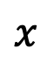
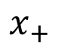
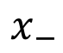
Rounding (roundoff) errors
Consider rounding by chopping:
Absolute error:
Relative error:
$$x_{−}$$
$$x$$
$$x_{+}$$
Notes:
The machine epsilon determines the maximum possible relative error in representing a non-zero real number x in a floating-point system.

Slide 8
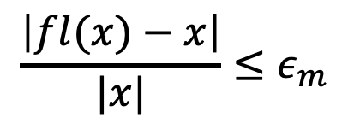
Rounding (roundoff) errors
$$\frac{\left|fl(x)−x\right|}{|x|}≤ε_{m}$$
The relative error due to rounding (the process of representing a real number as a machine number) is always bounded by machine epsilon.
Notes:
The machine epsilon determines the maximum possible relative error in representing a non-zero real number x in a floating-point system.

Slide 9
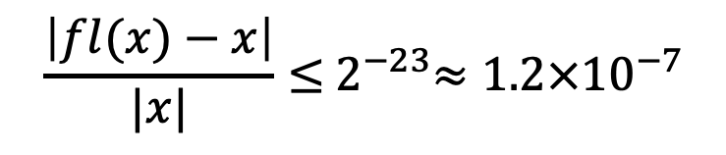
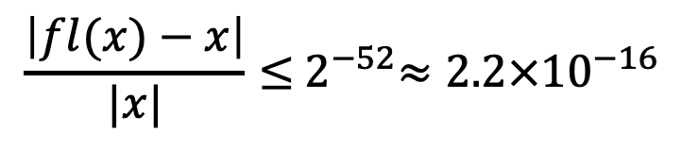
IEEE Single Precision
IEEE Double Precision
$$\frac{\left|fl(x)−x\right|}{|x|}≤{ 2}^{−23}≈{1.2×10}^{−7}$$
$$\frac{\left|fl(x)−x\right|}{|x|}≤{ 2}^{−52}≈{2.2×10}^{−16}$$
Notes:
The machine epsilon determines the maximum possible relative error in representing a non-zero real number x in a floating-point system.

Slide 10
Gap between two machine numbers
Notes:
D)

Slide 11
Video 2: Arithmetic with machine numbers

Slide 12
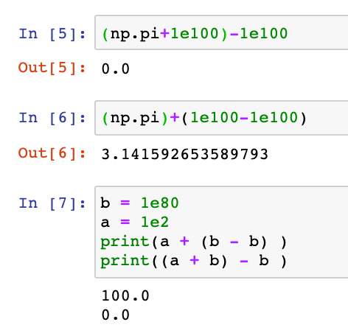
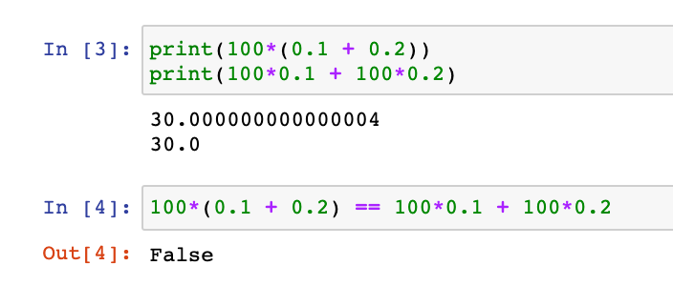

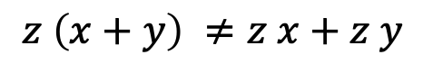

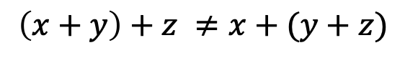
Mathematical properties of FP operations
Not necessarily associative:
For some $x , y,z$the result below is possible:
$$\left(x+y\right)+z ≠x+(y+z)$$
Not necessarily distributive:
For some $x , y,z$the result below is possible:
$$z \left(x+y\right) ≠z x+z y$$
Not necessarily cumulative:
Repeatedly adding a very small number to a large number may do nothing

Slide 13
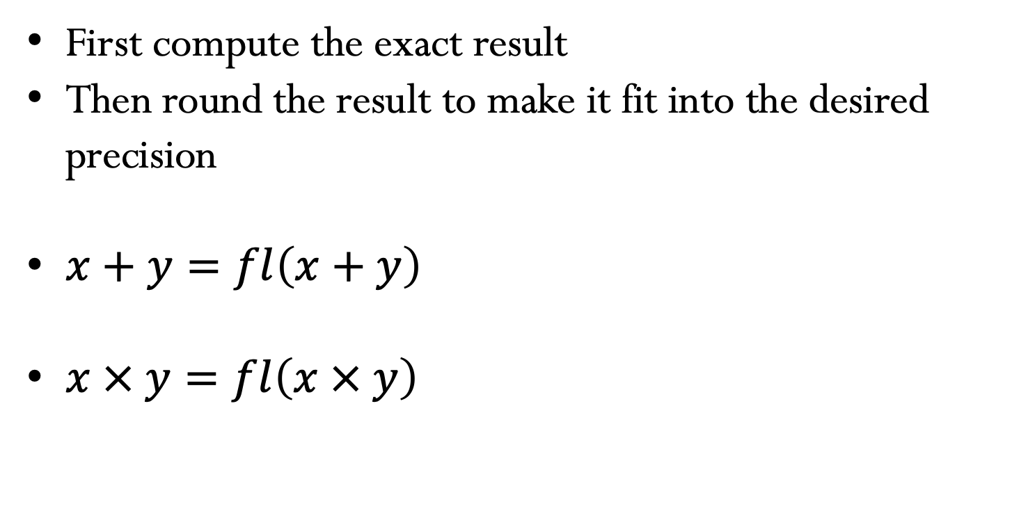
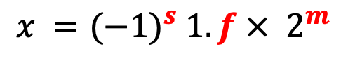
Floating point arithmetic (basic idea)
$$x ={(−1)}^{s} 1.f ×{ 2}^{m}$$
First compute the exact result
Then round the result to make it fit into the desired precision
$x+y=fl\left(x+y\right)$
$x × y=fl\left(x × y\right)$
Notes:
Add here about operations
Add in errors the notes about sigfig
Add in Taylor more detail about FD

Slide 14
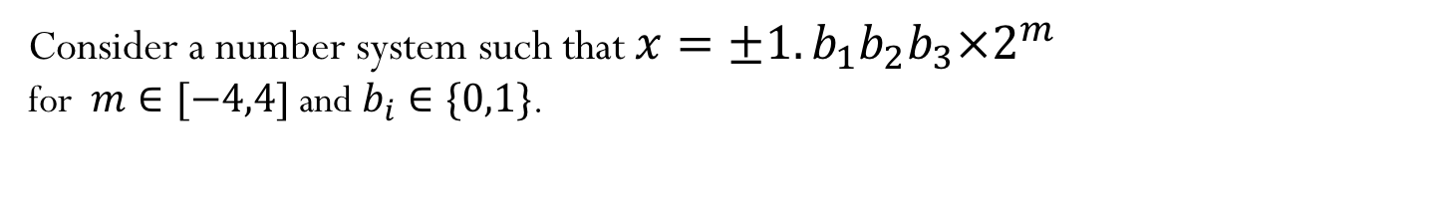
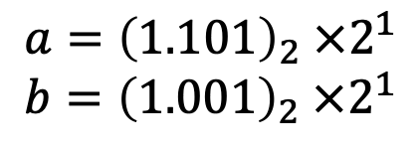
Floating point arithmetic
Consider a number system such that $x=±1.b_{1}b_{2}b_{3}×2^{m}$
for $m∈[−4,4]$ and $b_{i}∈\{0,1\}$.
Rough algorithm for addition and subtraction:
Bring both numbers onto a common exponent
Do “grade-school” operation
Round result
Example 1: No rounding needed
$${a=\left(1.101\right)}_{2} ×2^{1}$$
$${b=\left(1.001\right)}_{2} ×2^{1}$$
$${c=a+b=\left(10.110\right)}_{2} ×2^{1}={\left(1.011\right)}_{2} ×2^{2}$$

Slide 15
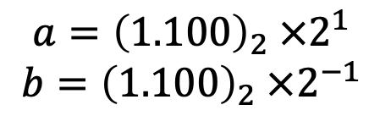
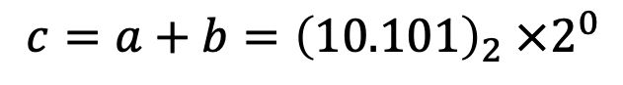
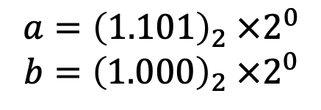
Floating point arithmetic
Consider a number system such that $x=±1.b_{1}b_{2}b_{3}×2^{m}$
for $m∈[−4,4]$ and $b_{i}∈\{0,1\}$.
Example 2: Require rounding
$${a=\left(1.101\right)}_{2} ×2^{0}$$
$${b=\left(1.000\right)}_{2} ×2^{0}$$
$${c=a+b=\left(10.101\right)}_{2} ×2^{0}$$
Example 3:
$${a=\left(1.100\right)}_{2} ×2^{1}$$
$${b=\left(1.100\right)}_{2} ×2^{−1}$$
$${c=a+b=\left(1.100\right)}_{2} ×2^{1}+{\left(0.011\right)}_{2} ×2^{1}={\left(1.111\right)}_{2} ×2^{1}$$

Slide 16
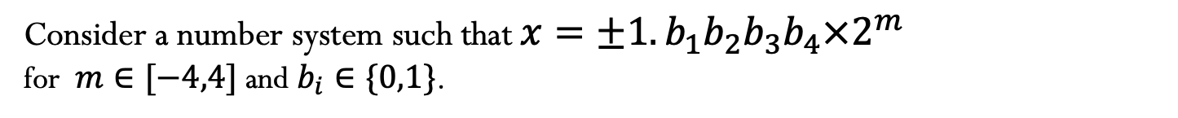
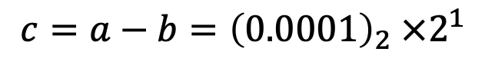
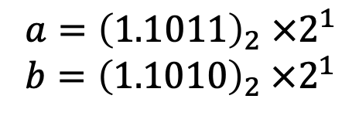
Floating point arithmetic
Consider a number system such that $x=±1.b_{1}b_{2}b_{3}b_{4}×2^{m}$
for $m∈[−4,4]$ and $b_{i}∈\{0,1\}$.
Example 4:
$${a=\left(1.1011\right)}_{2} ×2^{1}$$
$${b=\left(1.1010\right)}_{2} ×2^{1}$$
$${c=a−b=\left(0.0001\right)}_{2} ×2^{1}$$
Notes:
just mention in class that there are a few implementation details we aren’t discussing but if you are interested, you can go look at the reference material posted (it’s on the other reference material under floating point)

Slide 17
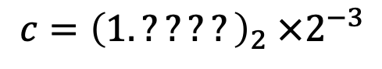
Floating point arithmetic
Consider a number system such that $x=±1.b_{1}b_{2}b_{3}b_{4}×2^{m}$
for $m∈[−4,4]$ and $b_{i}∈\{0,1\}$.
Example 4:
$${a=\left(1.1011\right)}_{2} ×2^{1}$$
$${b=\left(1.1010\right)}_{2} ×2^{1}$$
$${c=a−b=\left(0.0001\right)}_{2} ×2^{1}$$
Or after normalization:
$${c=\left(1.????\right)}_{2} ×2^{−3}$$
There is not data to indicate what the missing digits should be.
Machine fills them with its best guess, which is often not good (usually what is called spurious zeros).
Number of significant digits in the result is reduced.
This phenomenon is called Catastrophic Cancellation.
Notes:
just mention in class that there are a few implementation details we aren’t discussing but if you are interested, you can go look at the reference material posted (it’s on the other reference material under floating point)

Slide 18
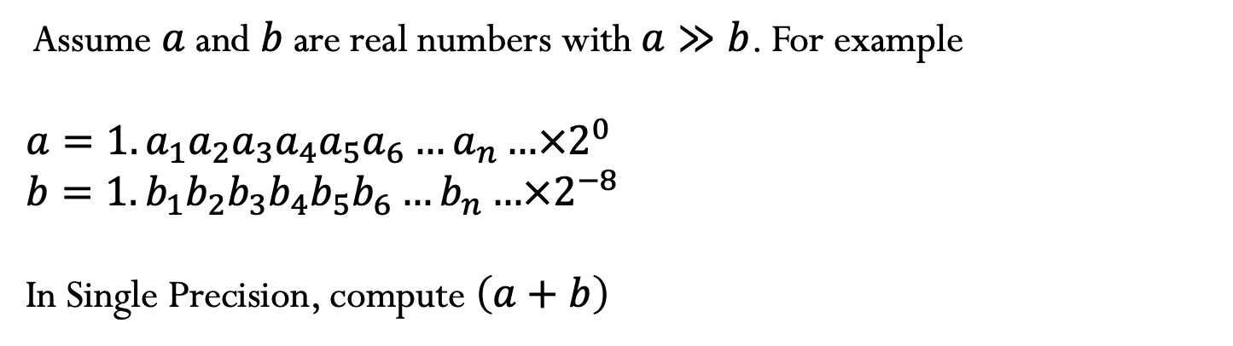
Loss of significance
Assume $a$ and $b$ are real numbers with $a≫b$. For example
$$a=1.a_{1}a_{2}a_{3}a_{4}a_{5}a_{6}…a_{n}…×2^{0}$$
$$b=1.b_{1}b_{2}b_{3}b_{4}b_{5}b_{6}…b_{n}…×2^{−8}$$
In Single Precision, compute $\left(a+b\right)$
$$1.a_{1}a_{2}a_{3}a_{4}a_{5}a_{6}a_{7}a_{8}a_{9}…a_{22}a_{23}×2^{0}$$
Notes:
just mention in class that there are a few implementation details we aren’t discussing but if you are interested, you can go look at the reference material posted (it’s on the other reference material under floating point)

Slide 19
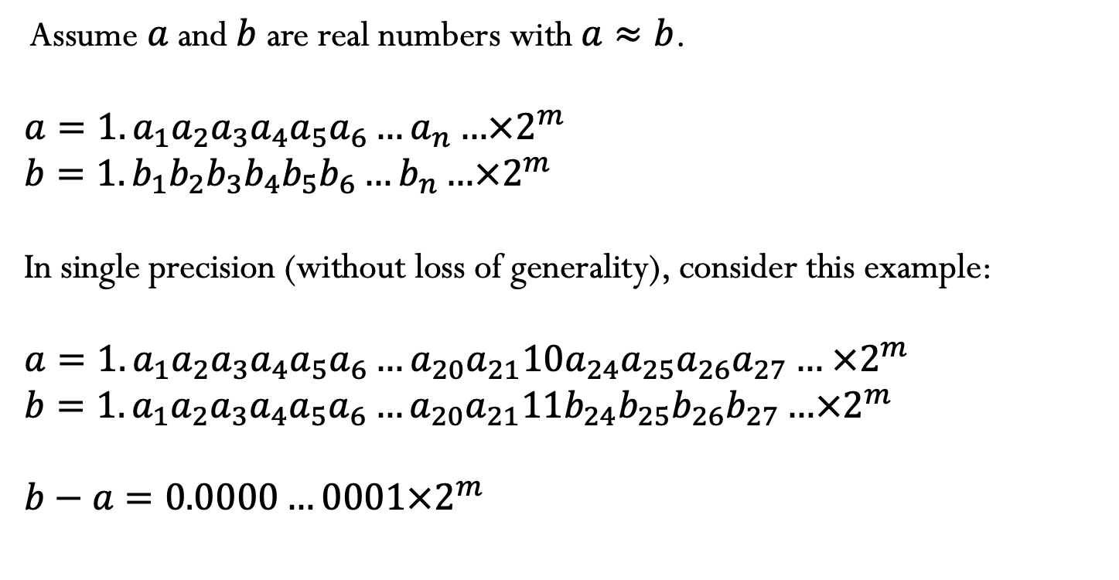
Cancellation
Assume $a$ and $b$ are real numbers with $a≈b$.
$$a=1.a_{1}a_{2}a_{3}a_{4}a_{5}a_{6}…a_{n}…×2^{m}$$
$$b=1.b_{1}b_{2}b_{3}b_{4}b_{5}b_{6}…b_{n}…×2^{m}$$
In single precision (without loss of generality), consider this example:
$$a=1.a_{1}a_{2}a_{3}a_{4}a_{5}a_{6}…a_{20}a_{21}10a_{24}a_{25}a_{26}a_{27}… ×2^{m}$$
$$b=1.a_{1}a_{2}a_{3}a_{4}a_{5}a_{6}…a_{20}a_{21}11b_{24}b_{25}b_{26}b_{27}…×2^{m}$$
$$b−a=0.0000…0001×2^{m}$$
Notes:
just mention in class that there are a few implementation details we aren’t discussing but if you are interested, you can go look at the reference material posted (it’s on the other reference material under floating point)

Slide 20
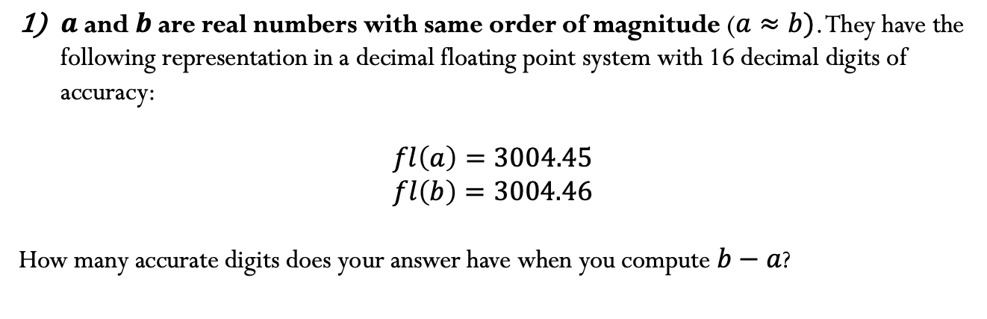
Examples:
$a$ and $b$ are real numbers with same order of magnitude ($a≈b)$. They have the following representation in a decimal floating point system with 16 decimal digits of accuracy:
$$fl\left(a\right)=3004.45$$
$$fl\left(b\right)=3004.46$$
How many accurate digits does your answer have when you compute $b−a$?
Notes:
just mention in class that there are a few implementation details we aren’t discussing but if you are interested, you can go look at the reference material posted (it’s on the other reference material under floating point)

Slide 21
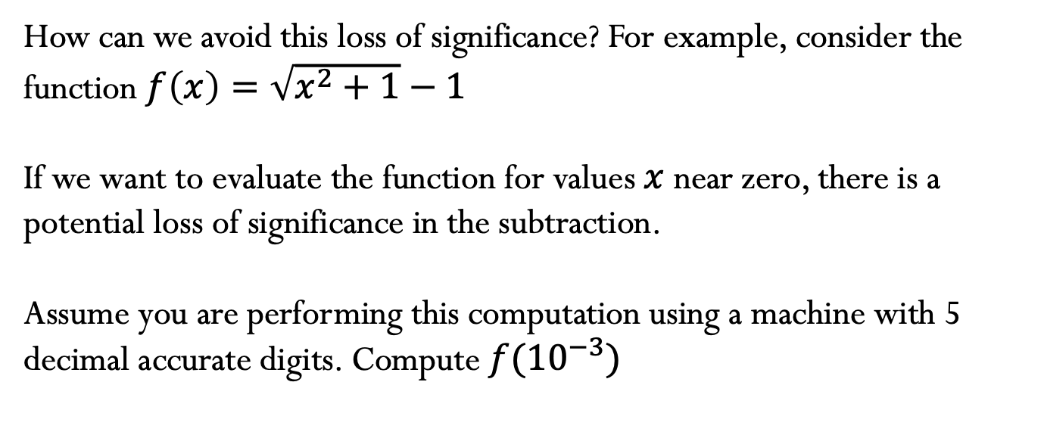
Loss of Significance
How can we avoid this loss of significance? For example, consider the function $f\left(x\right)=\sqrt{x^{2}+1}−1$
If we want to evaluate the function for values $x$ near zero, there is a potential loss of significance in the subtraction.
Assume you are performing this computation using a machine with 5 decimal accurate digits. Compute $f{(10}^{−3})$

Slide 22
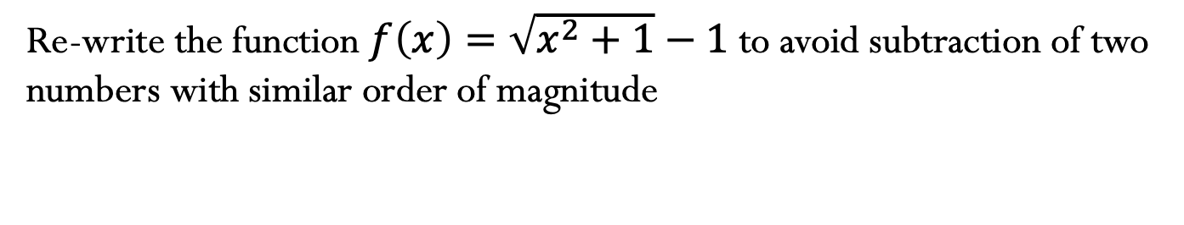
Loss of Significance
Re-write the function $f\left(x\right)=\sqrt{x^{2}+1}−1$ to avoid subtraction of two numbers with similar order of magnitude

Slide 23
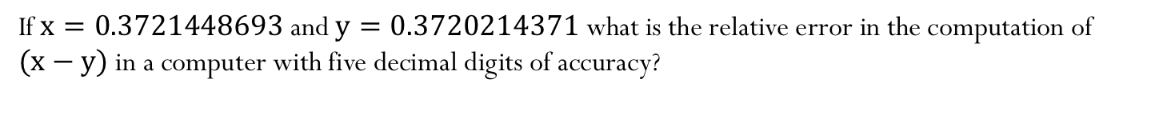
Example:
If$x=0.3721448693$ and $y=0.3720214371$what is the relative error in the computation of $(x−y)$ in a computer with five decimal digits of accuracy?
Notes:
The relative error is in fact ~1.3 * 10^(-5)

Slide 24
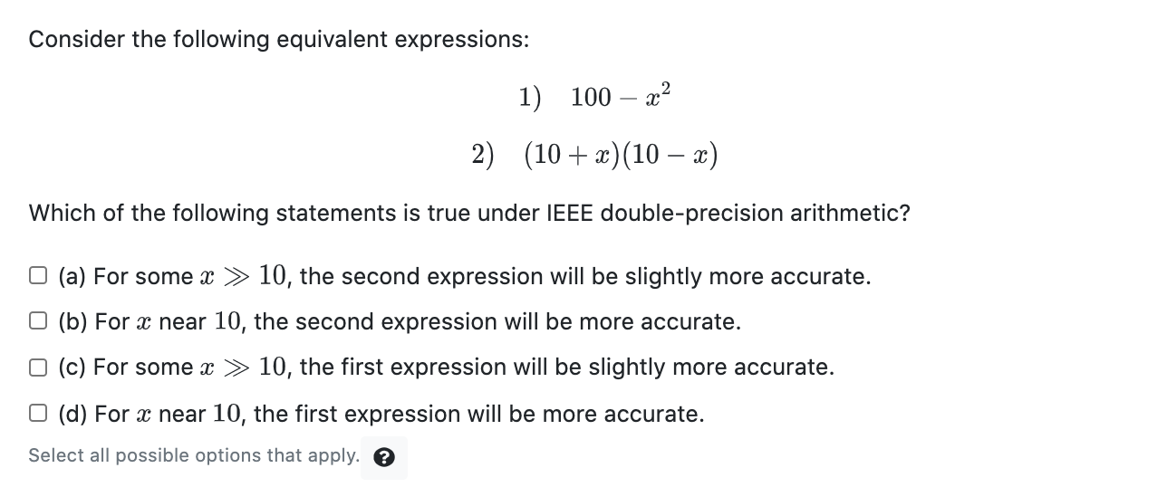
Example:
Case A: x >> 10
Neither Eq.(1) or (2) will have severe cancelation. They will however have loss of significance due to rounding errors (rounding when we represent the numbers in finite precision, and rounding performed after each operation). The more operations we have, the more propagation of these errors will be built in our final result. In Eq(1), we have two operations: we square x and then we make the subtraction. There will be loss of significance in both of these operations. In Eq(2) we perform three operations: we compute 10+x, then (10-x), and we multiply these results. There is more opportunity for rounding errors in the computation of Eq(2), and that is why we just use the wording “Eq 2 is slightly more accurate”. As a rule of thumb, as we discussed earlier, the less number of operations will lead to more accurate results.
Case B: x near 10
As we discussed, both Eqs.(1) and (2) will be at risk of cancelation, since we are losing the digits that are the most significant ones. When we square the value x (near 10 in this case), we are introducing more rounding error (we talked about how we are already losing some of the precision here), and so the computation of (100-x^2) is more severe than the computation of (10-x).
One thing that we briefly discussed is that cancelation is a “product” of rounding errors (due to finite representation of numbers). If we were doing computation with infinite precision (or a number could be represented exactly), then we can’t have cancelation. If we are computing “by-hand” 40-39.999 = 0.001, we don’t have any “loss of precision” or cancelation, and our result is exact. However, when using machines, numbers are often not represented exactly, and because of rounding, we have the issue of cancelation.
Going back to the example above, suppose the number x “near” is represented exactly. In that case, the computation of 10-x does not have any cancelation, because there is no rounding. However, the computation of the square of x can lead to rounding errors, and consequently, the computation of 100-x^2 can lead to cancelation.
The point above goes beyond of what was needed to answer the question correctly, but you can see that, no matter the choice of x near 10, you would still have Eq.(2) having more accurate results than Eq.(1).

